Slide 1
PAPU, a Gameboy sound emulator
Synth 101, group 8

Slide 2
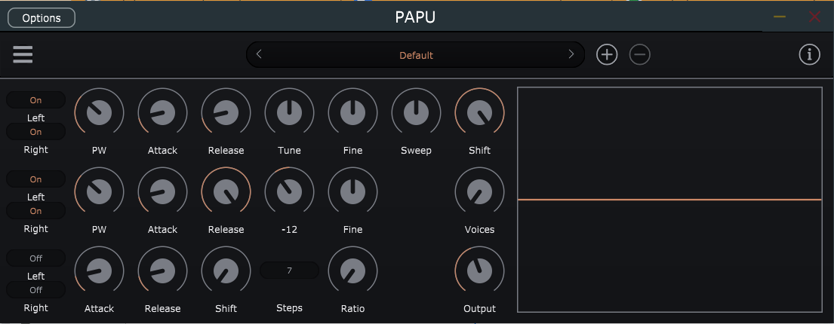
Graphical User Interface

Slide 3
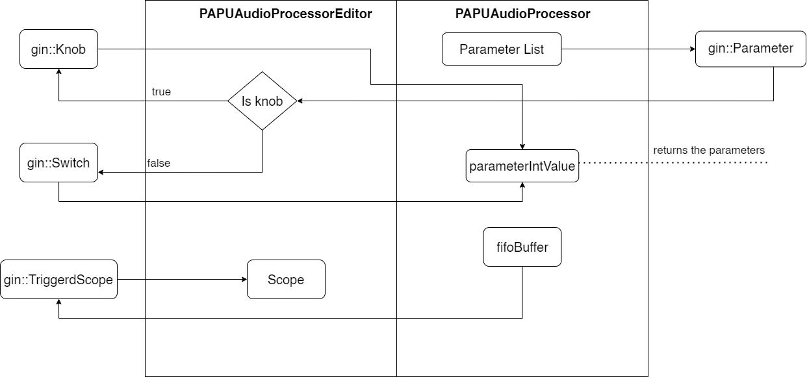
GUI block chain

Slide 4
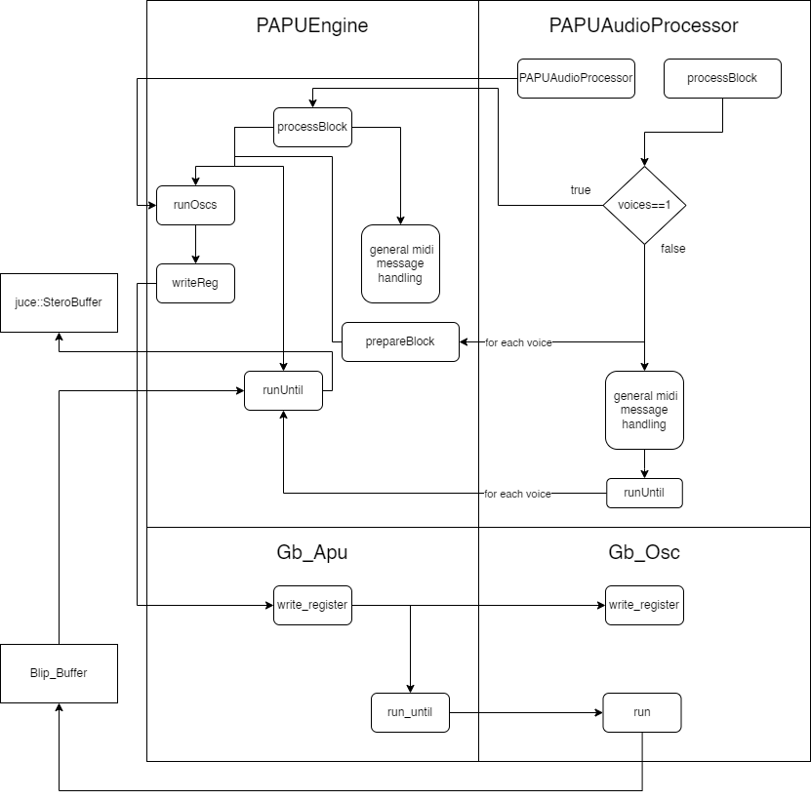
Audio Block chain
PAPUEngine and PAPUAudioProcessor are classes included in the juce source files
Gb_Apu, Gb_Osc and Blip_Buffer come instead from a library that emulates the sound chip of a gameboy
The output is then sent to a stereo buffer implemented using a juce class

Slide 5
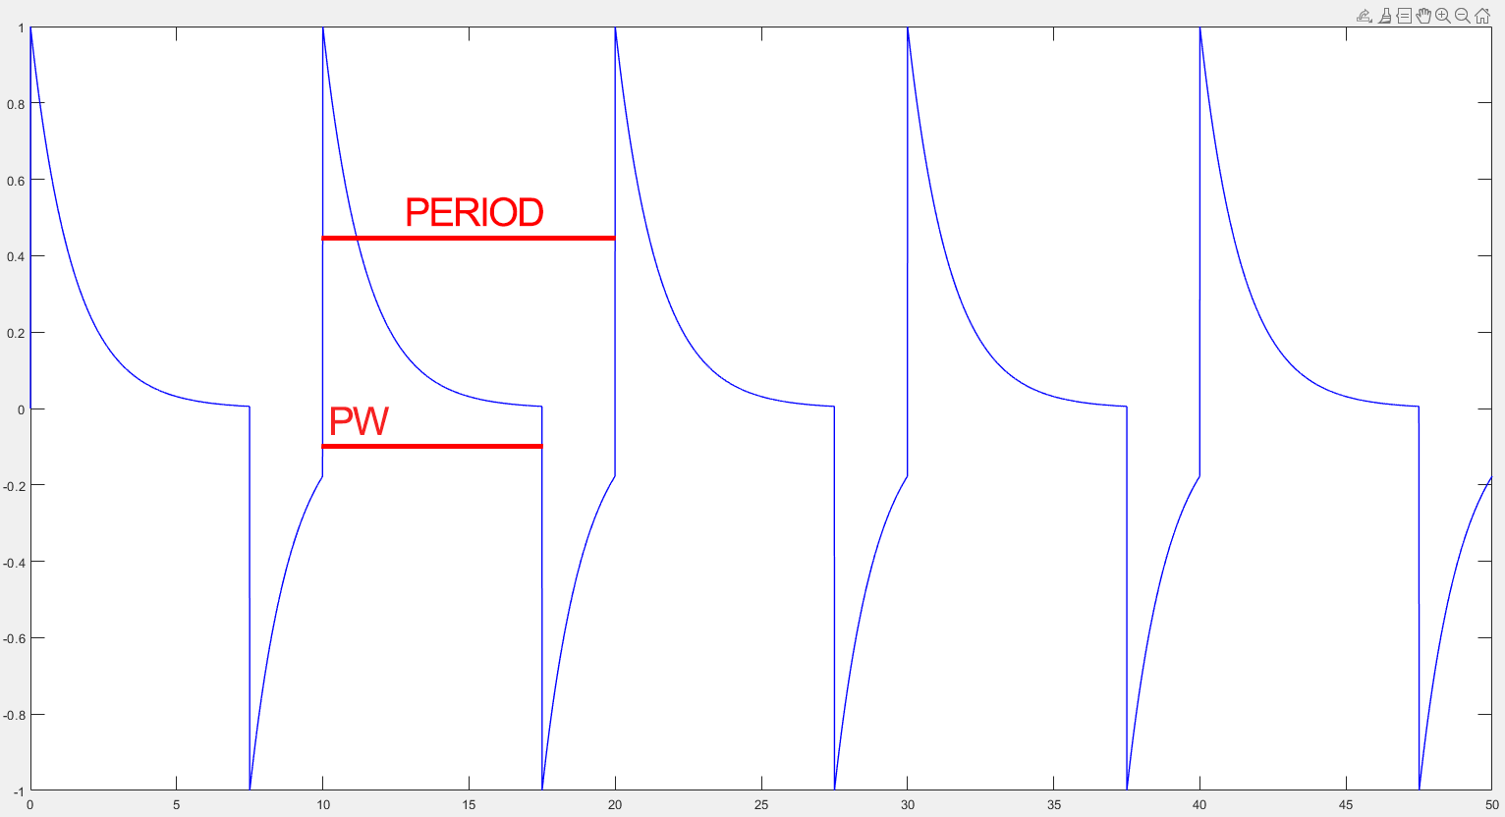
Additional features

